Slide 1

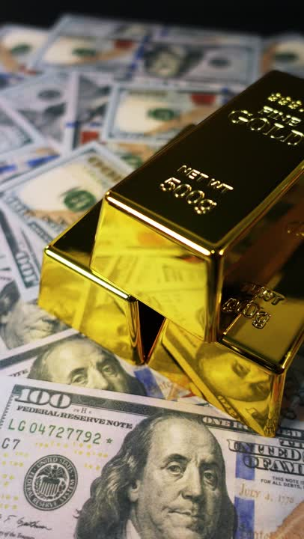




Wealth in Metals:
Your Guide to Gold and Silver Bar Investments
Talal Ramadhan
@RamadhanTalal

Slide 2
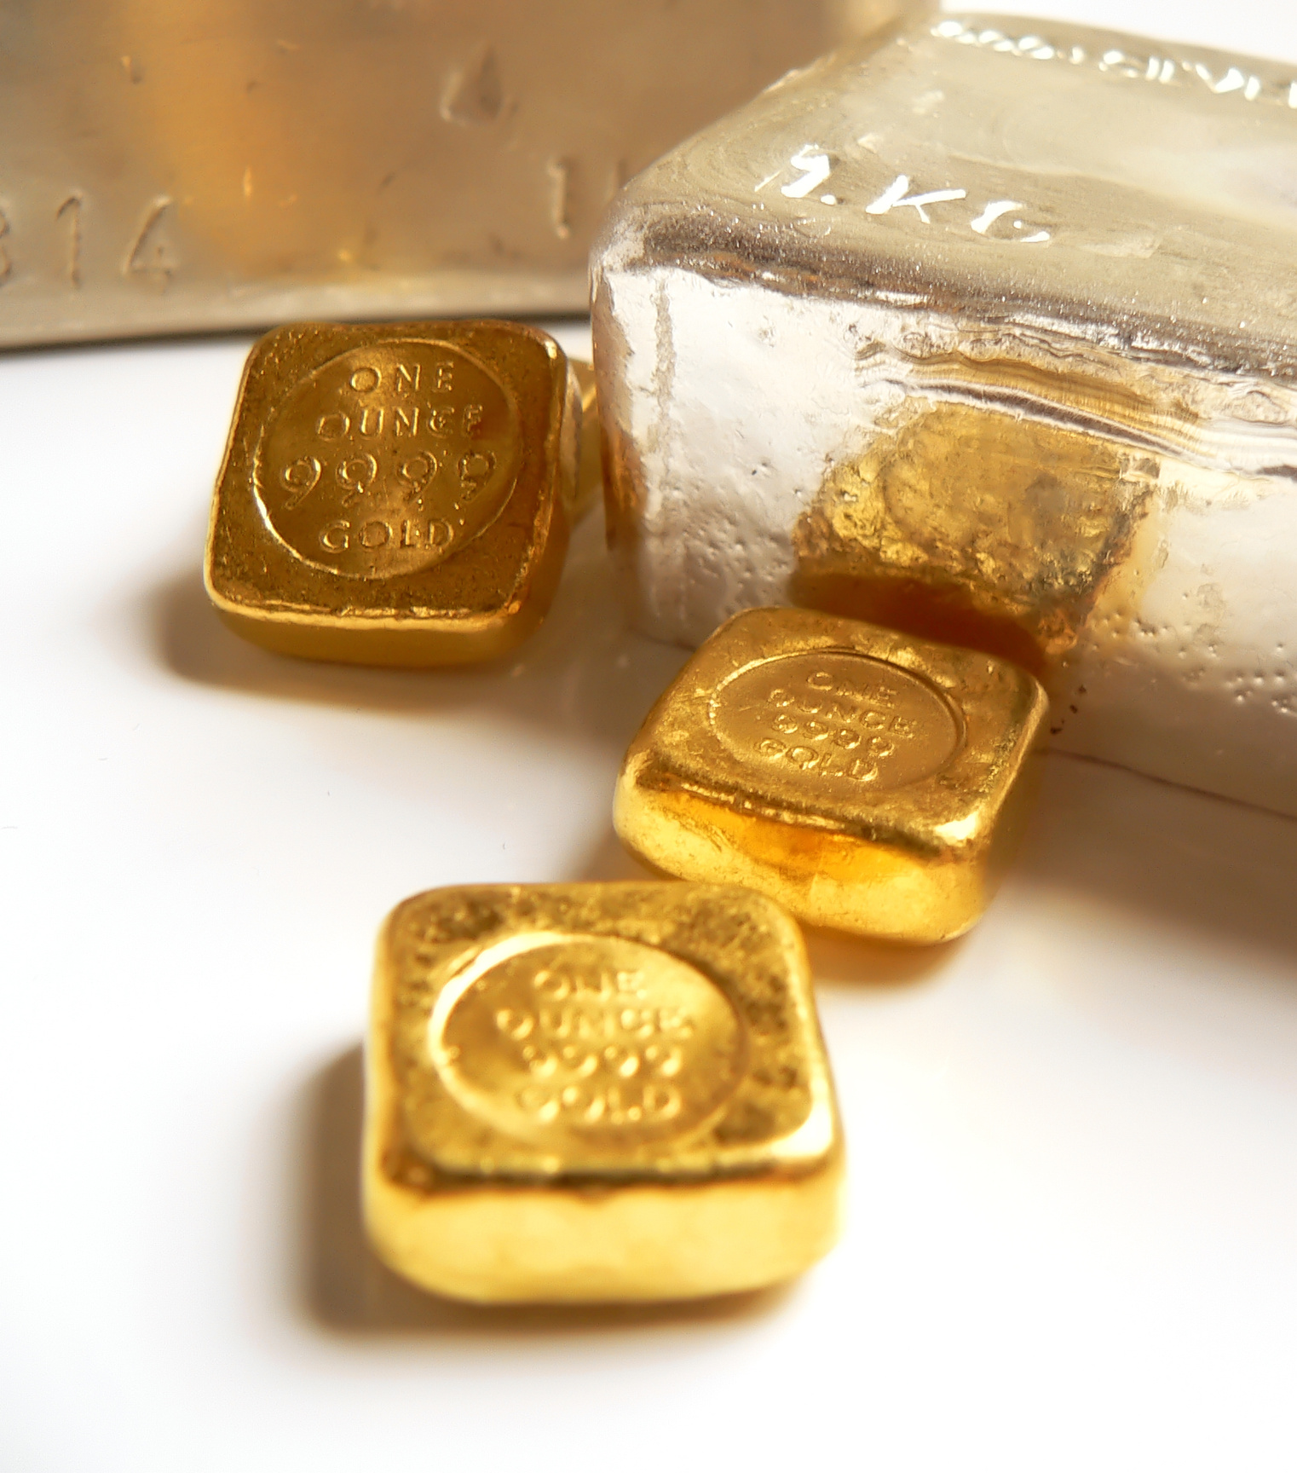
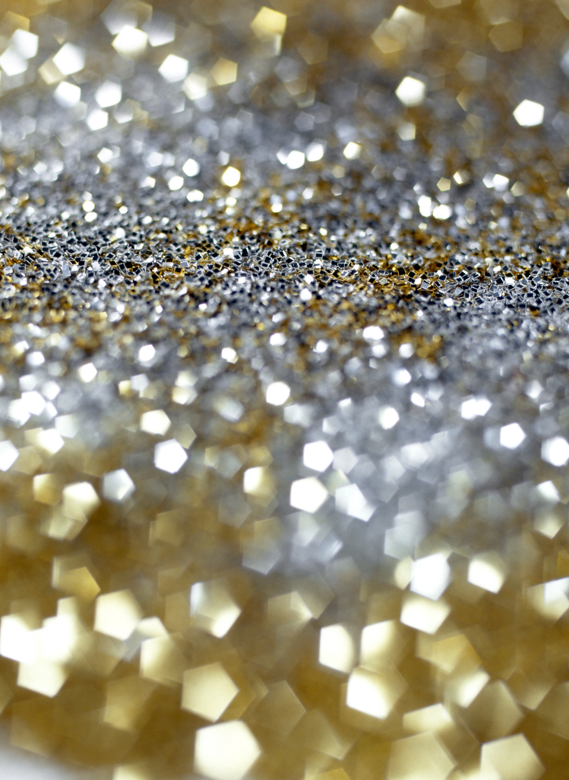
1
Introduction to Precious Metal Investing
2
Gold vs Silver: Key Differences
3
Pros and Cons of Gold and Silver
Table of Contents
4
Types and Weights of Bars
5
How and Where to Buy Gold and Silver Bars
6
How to Invest in Gold and Silver Bars
7
Historical Price Performance and ROI
8
Legal and Tax Considerations in Bahrain
9
The Future of Gold and Silver

Slide 3
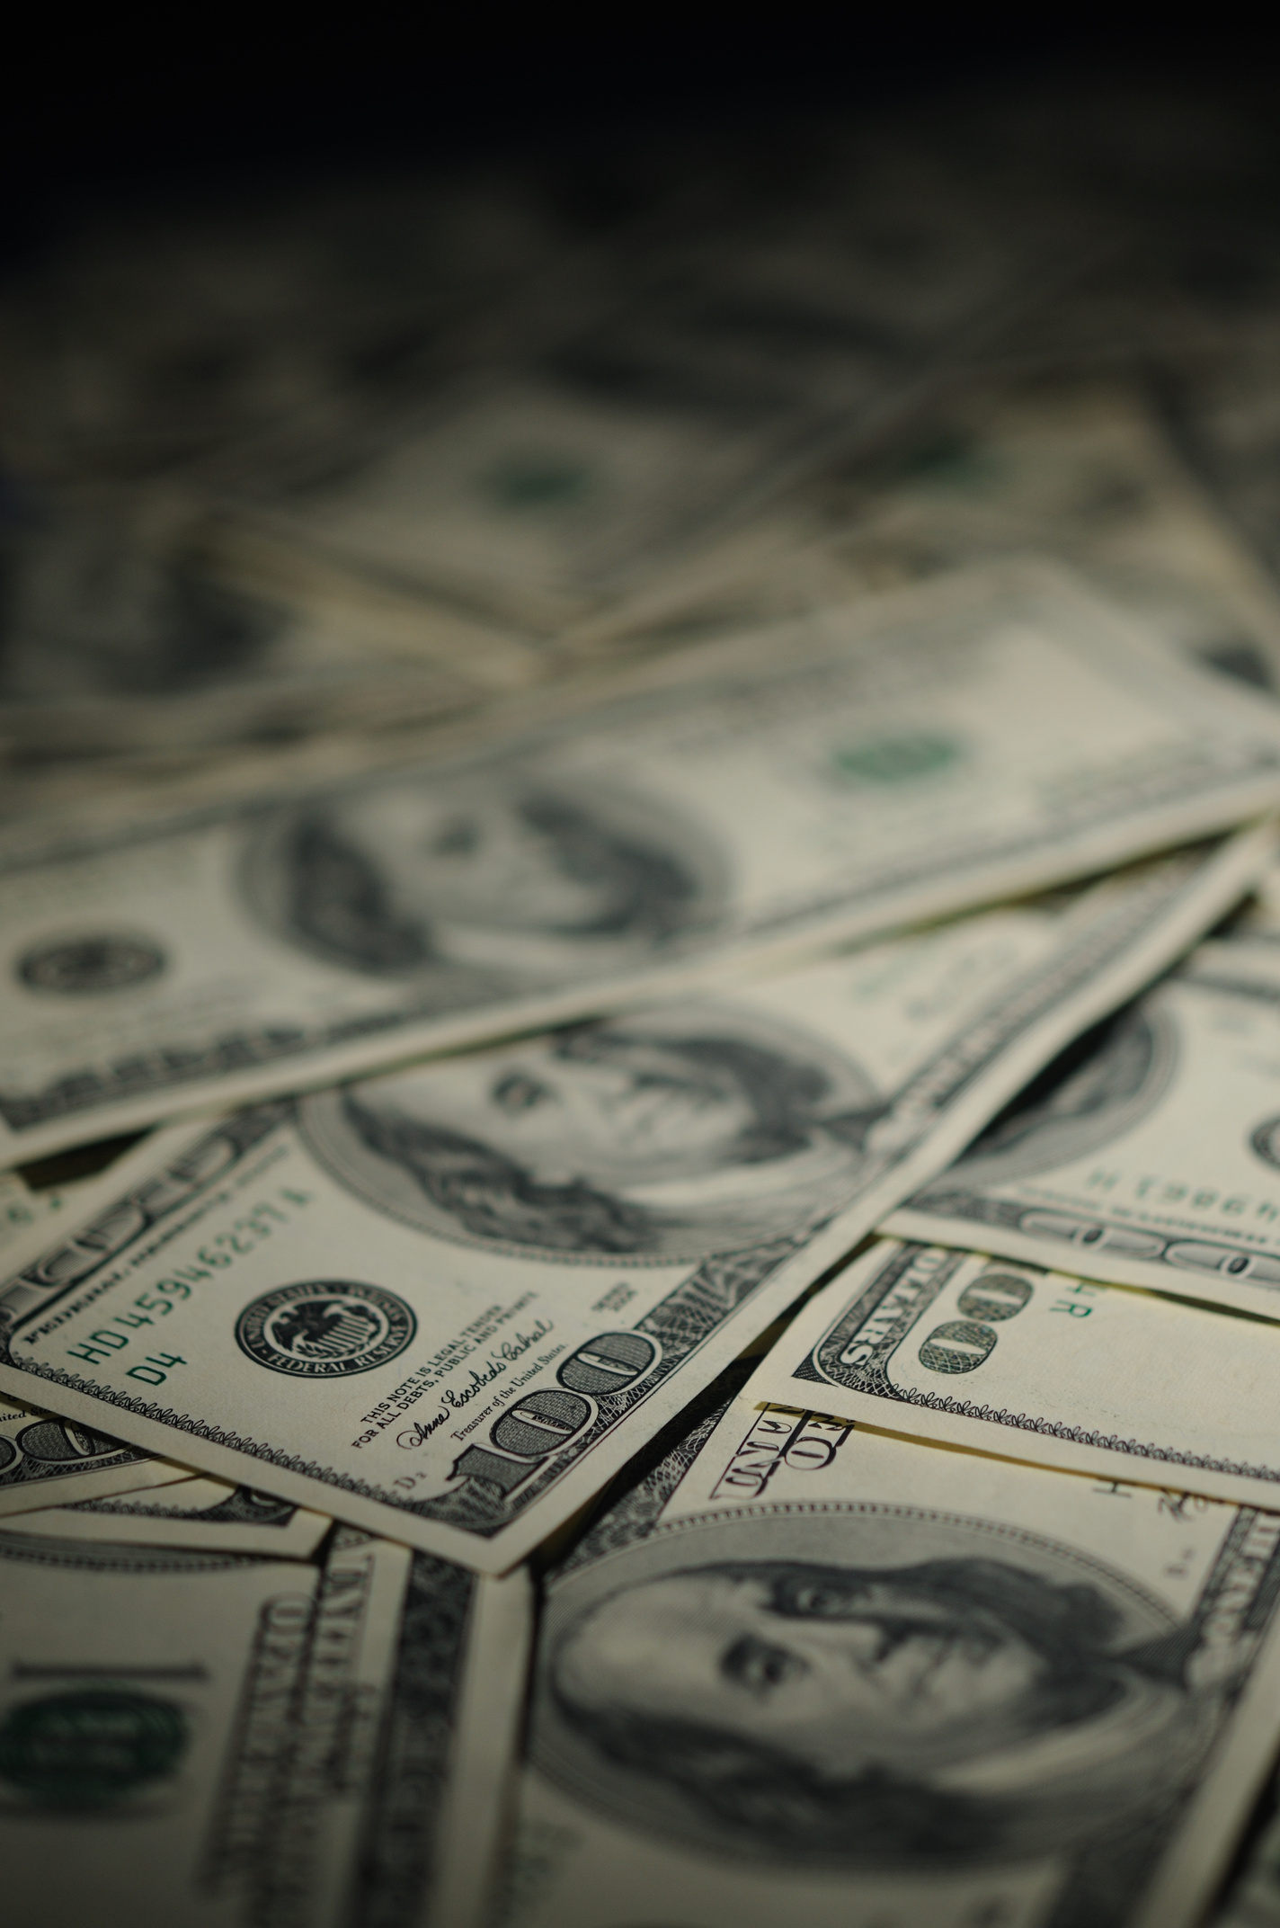
Introduction to Precious Metal Investing
  Gold and silver have been used for thousands of years as stores of value
  Investors use precious metals to hedge against inflation, protect against currency devaluation, and diversify portfolios
  Physical metals offer safety in times of economic or geopolitical uncertainty
  These assets are tangible, globally recognized, and require no counterparty trust

Slide 4
Gold vs Silver: Key Differences
Feature | Gold Bars | Silver Bars
Price per gram | Higher | Lower
Volatility | Lower | Higher
Industrial demand | Low | High (used in tech and energy)
Storage space needed | Less | More
Liquidity | Very high | High
Entry cost | High | Low
Tax/VAT implications | Often exempt | Sometimes taxed depending on region

Slide 5

Gold
Vs
Silver
Pros
Pros
Pros and Cons of Gold and Silver
  Global reserve asset
  Compact and efficient storage
  Stable long-term store of value
  Affordable to start investing
  Strong upside potential due to industrial use
  Often outperforms gold during economic expansion
Cons
Cons
  High entry price
  Slower upside in bull markets
  Bulky
  More price volatility
  Lower liquidity than gold

Slide 6
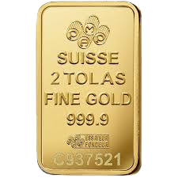
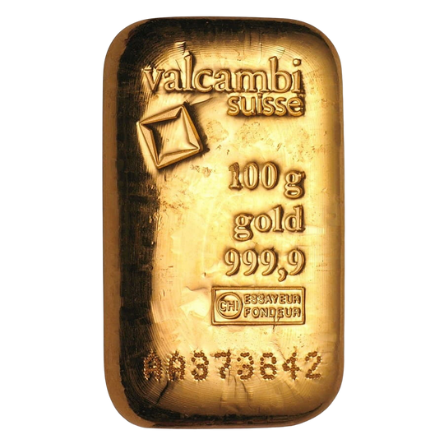
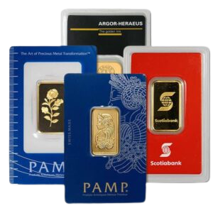
Types and Weights of Bars
  1g, 5g, 10g, 20g, 50g, 100g, 250g, 500g, 1kg
  1 ounce, 10 ounces (especially common in silver)
  Cast bars: Cheaper, rough finish, good for large investments
  Minted bars: Smooth, polished, premium look
  Gold: 999.9 (24K)
  Silver: 999 (fine silver)
  Serial number
  Refiner logo (e.g. PAMP, Valcambi, Emirates Gold)
  Certificate of authenticity
Standard Weights
Bar Types
Purity
Important Features

Slide 7

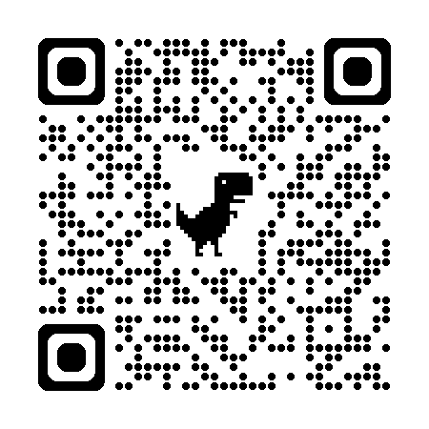
How and Where to Buy Gold and Silver Bars in Bahrain?
Local Trusted Sellers (Bahrain)
What to Check Before Buying
  Almerriyah Jewellery
  Khalaf Gold
  MSS Jewellery
  Bullion Mart Gold & Jewellery Trading
  Rizan Bullion
  LBMA certification
  Hallmark and serial number
  Invoicing and transparency
  Buyback policy
  Reputation and reviews
Online Platforms
  Not recommended, except for rate fixing

Slide 8
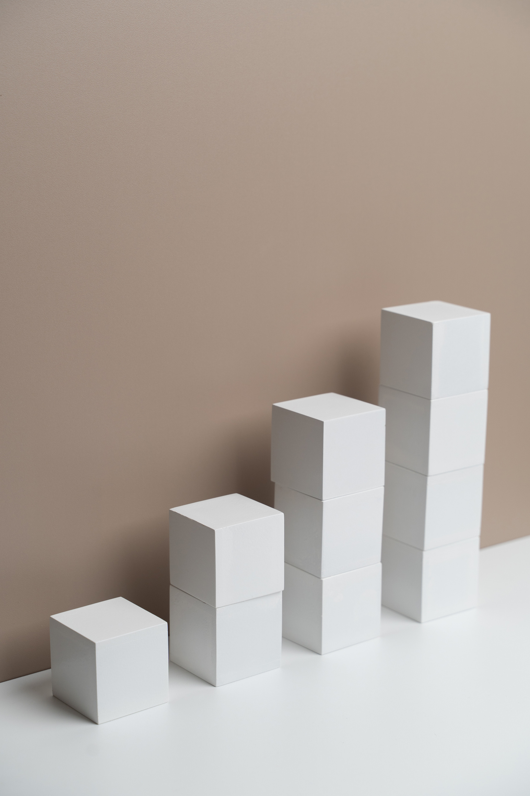
How to Invest in Gold and Silver Bars
Investment Methods
  Direct purchase: Take physical possession
  Bank or private vault storage
  Gold/silver savings plans: Monthly contribution plans
  Pooled accounts: Fractional ownership of large bars
  Dollar-cost averaging: Reduces risk over time
Things to Consider
  Insurance and storage cost
  Liquidity (ease of resale)
  Long-term vs short-term goals

Slide 9
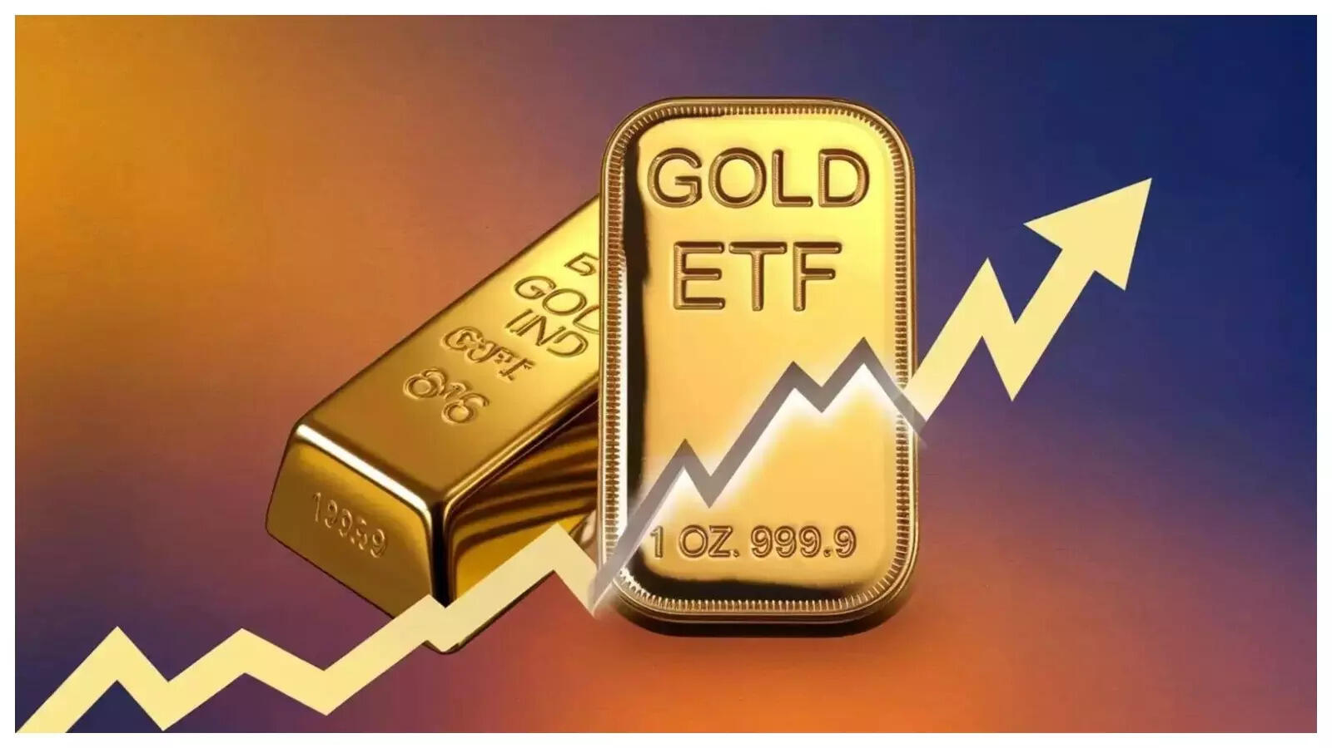
Investing in Gold and Silver Exchange Traded Funds, ETFs
What are gold and silver ETFs?
Investment funds that are traded on stock exchanges, they track the price of gold and silver and give investors exposure without the need to physically own the metals.
Liquidity, easy buying and selling in financial markets.
Cost efficiency, no storage or insurance costs
Portfolio diversification, gold and silver are assets not closely tied to traditional markets.
Transparency, prices usually reflect spot gold and silver prices accurately.
Market volatility, prices fluctuate with movements in gold and silver markets.
Management fees, small fees may affect long term returns.
Tracking error, possible slight differences between fund performance and actual gold or silver prices.
Benefits
Most popular gold and silver ETFs:
SPDR Gold Shares (GLD)
iShares Gold Trust (IAU)
iShares Silver Trust (SLV)
Invesco DB Silver Fund (DBS)
Suitable for:
Investors seeking inflation hedging, a safe haven, or strategic portfolio diversification.
Potential risks

Slide 10
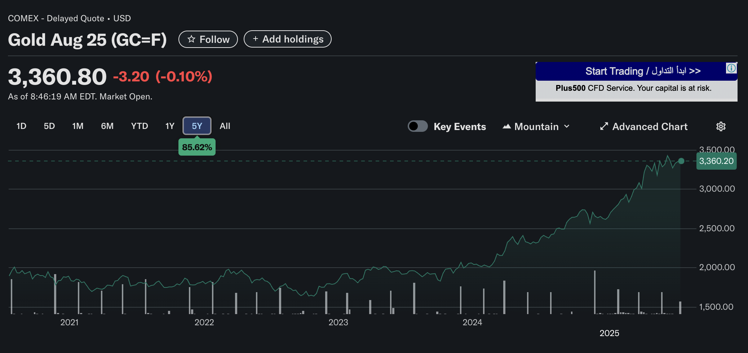
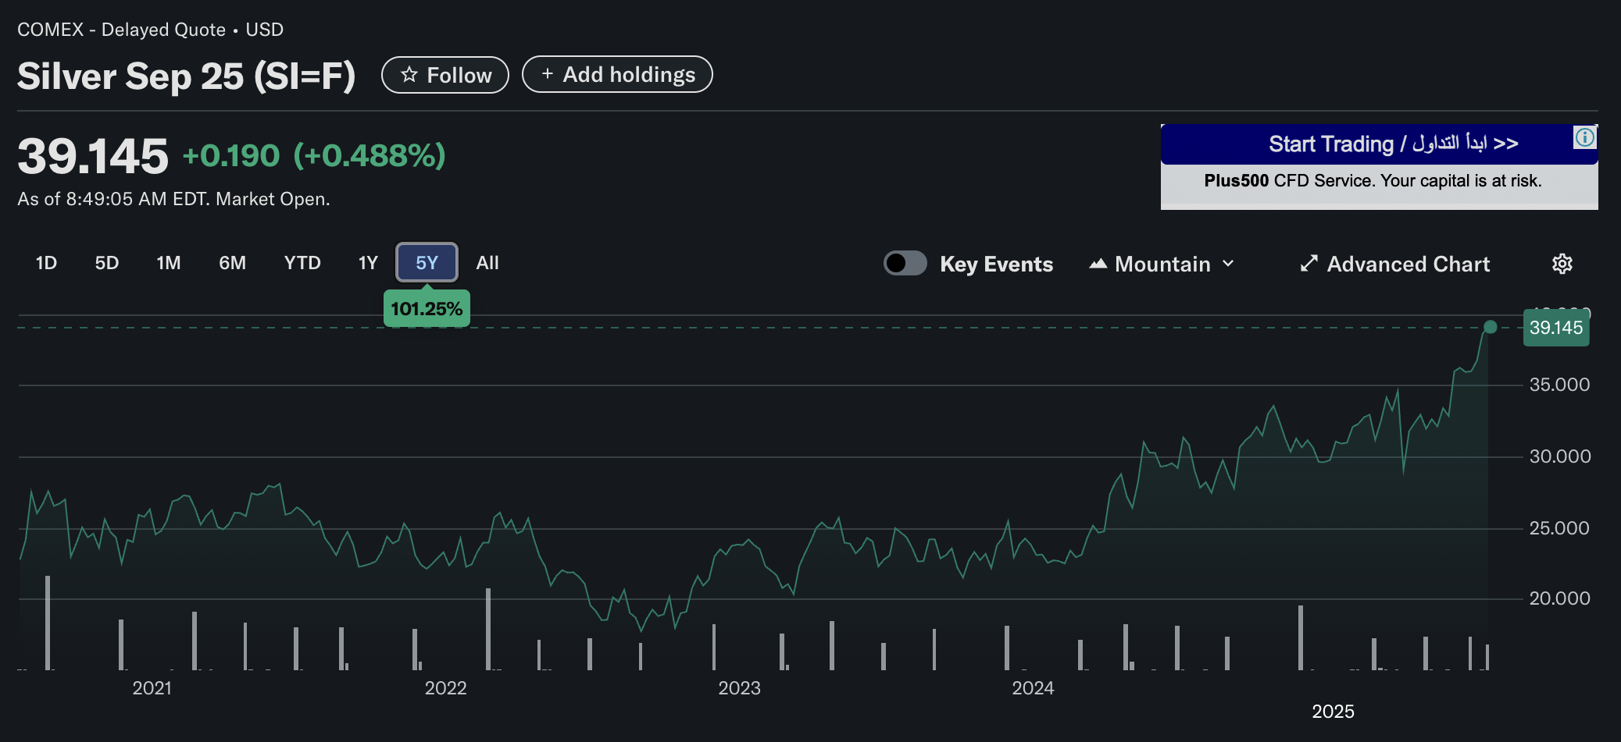
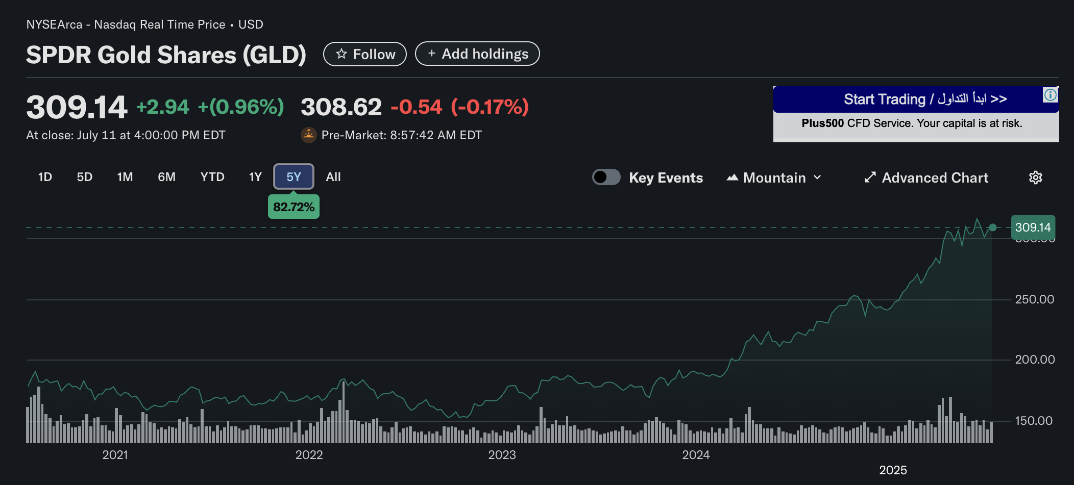
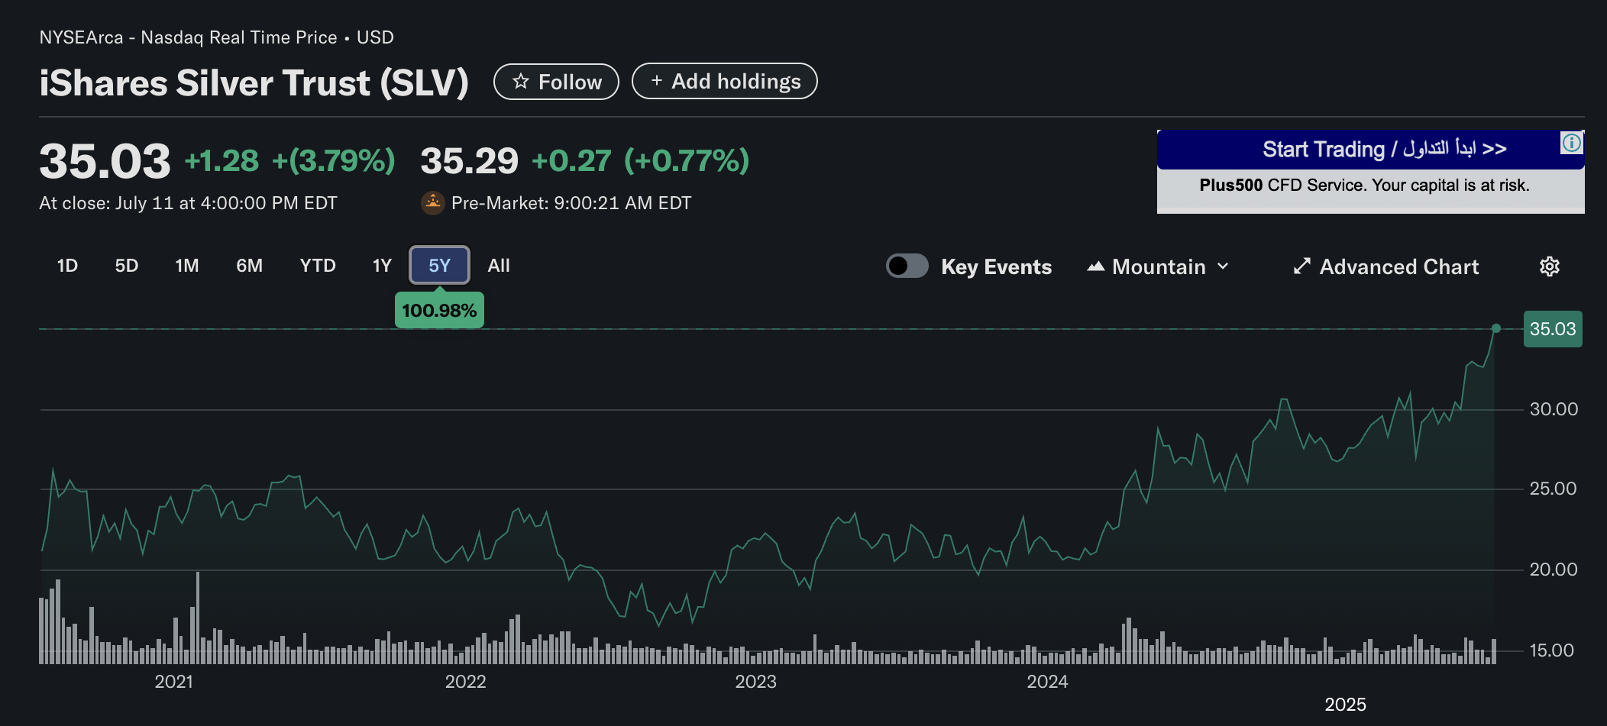
Gold
Silver
Gold ETF
Silver ETF

Slide 11
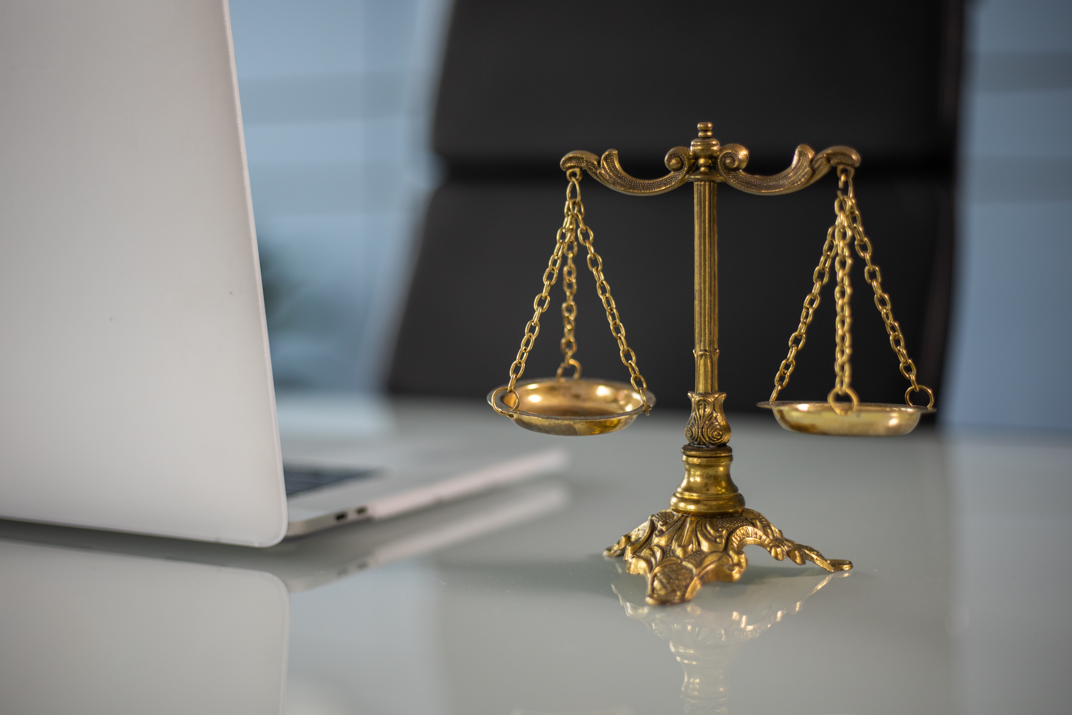
Legal and Tax Considerations in Bahrain
  No capital gains tax in Bahrain
  Gold bars and silver bars are VAT exempted
  Keep invoices and certificates for future resale or audits
  Always purchase from licensed and registered dealers

Slide 12
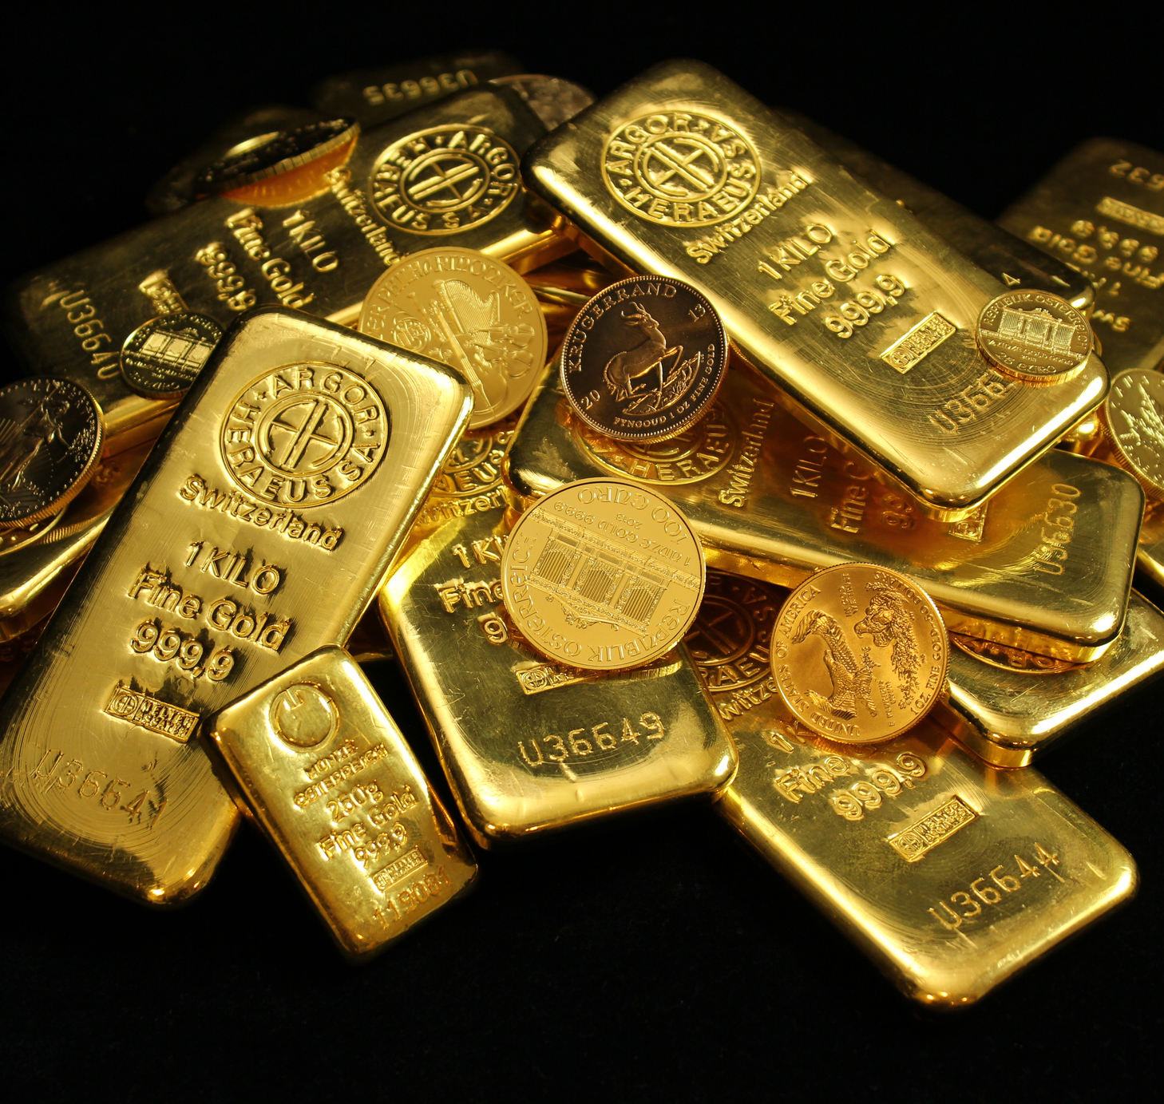
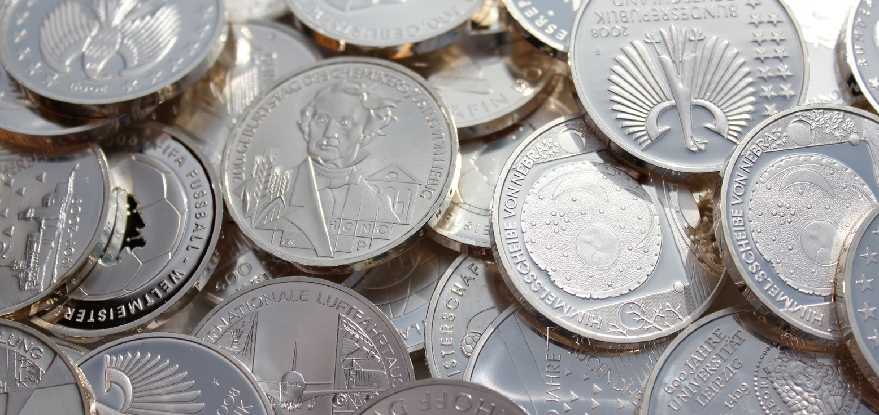
Historical Price Performance and ROI
  July 2020: BD 22.5 per gram
  July 2025: BD 27.2 per gram
  5-year growth: 21%
If you invested BD 1,000 in 2020:
Gold
  44.4 grams of gold
  Worth BD 1,209 in 2025
  Gain: BD 209 (21%)
  July 2020: BD 0.25 per gram
  July 2025: BD 0.33 per gram
  5-year growth: 32%
If you invested BD 1,000 in 2020:
Silver
  4,000 grams of silver
  Worth BD 1,320 in 2025
  Gain: BD 320 (32%)

Slide 13
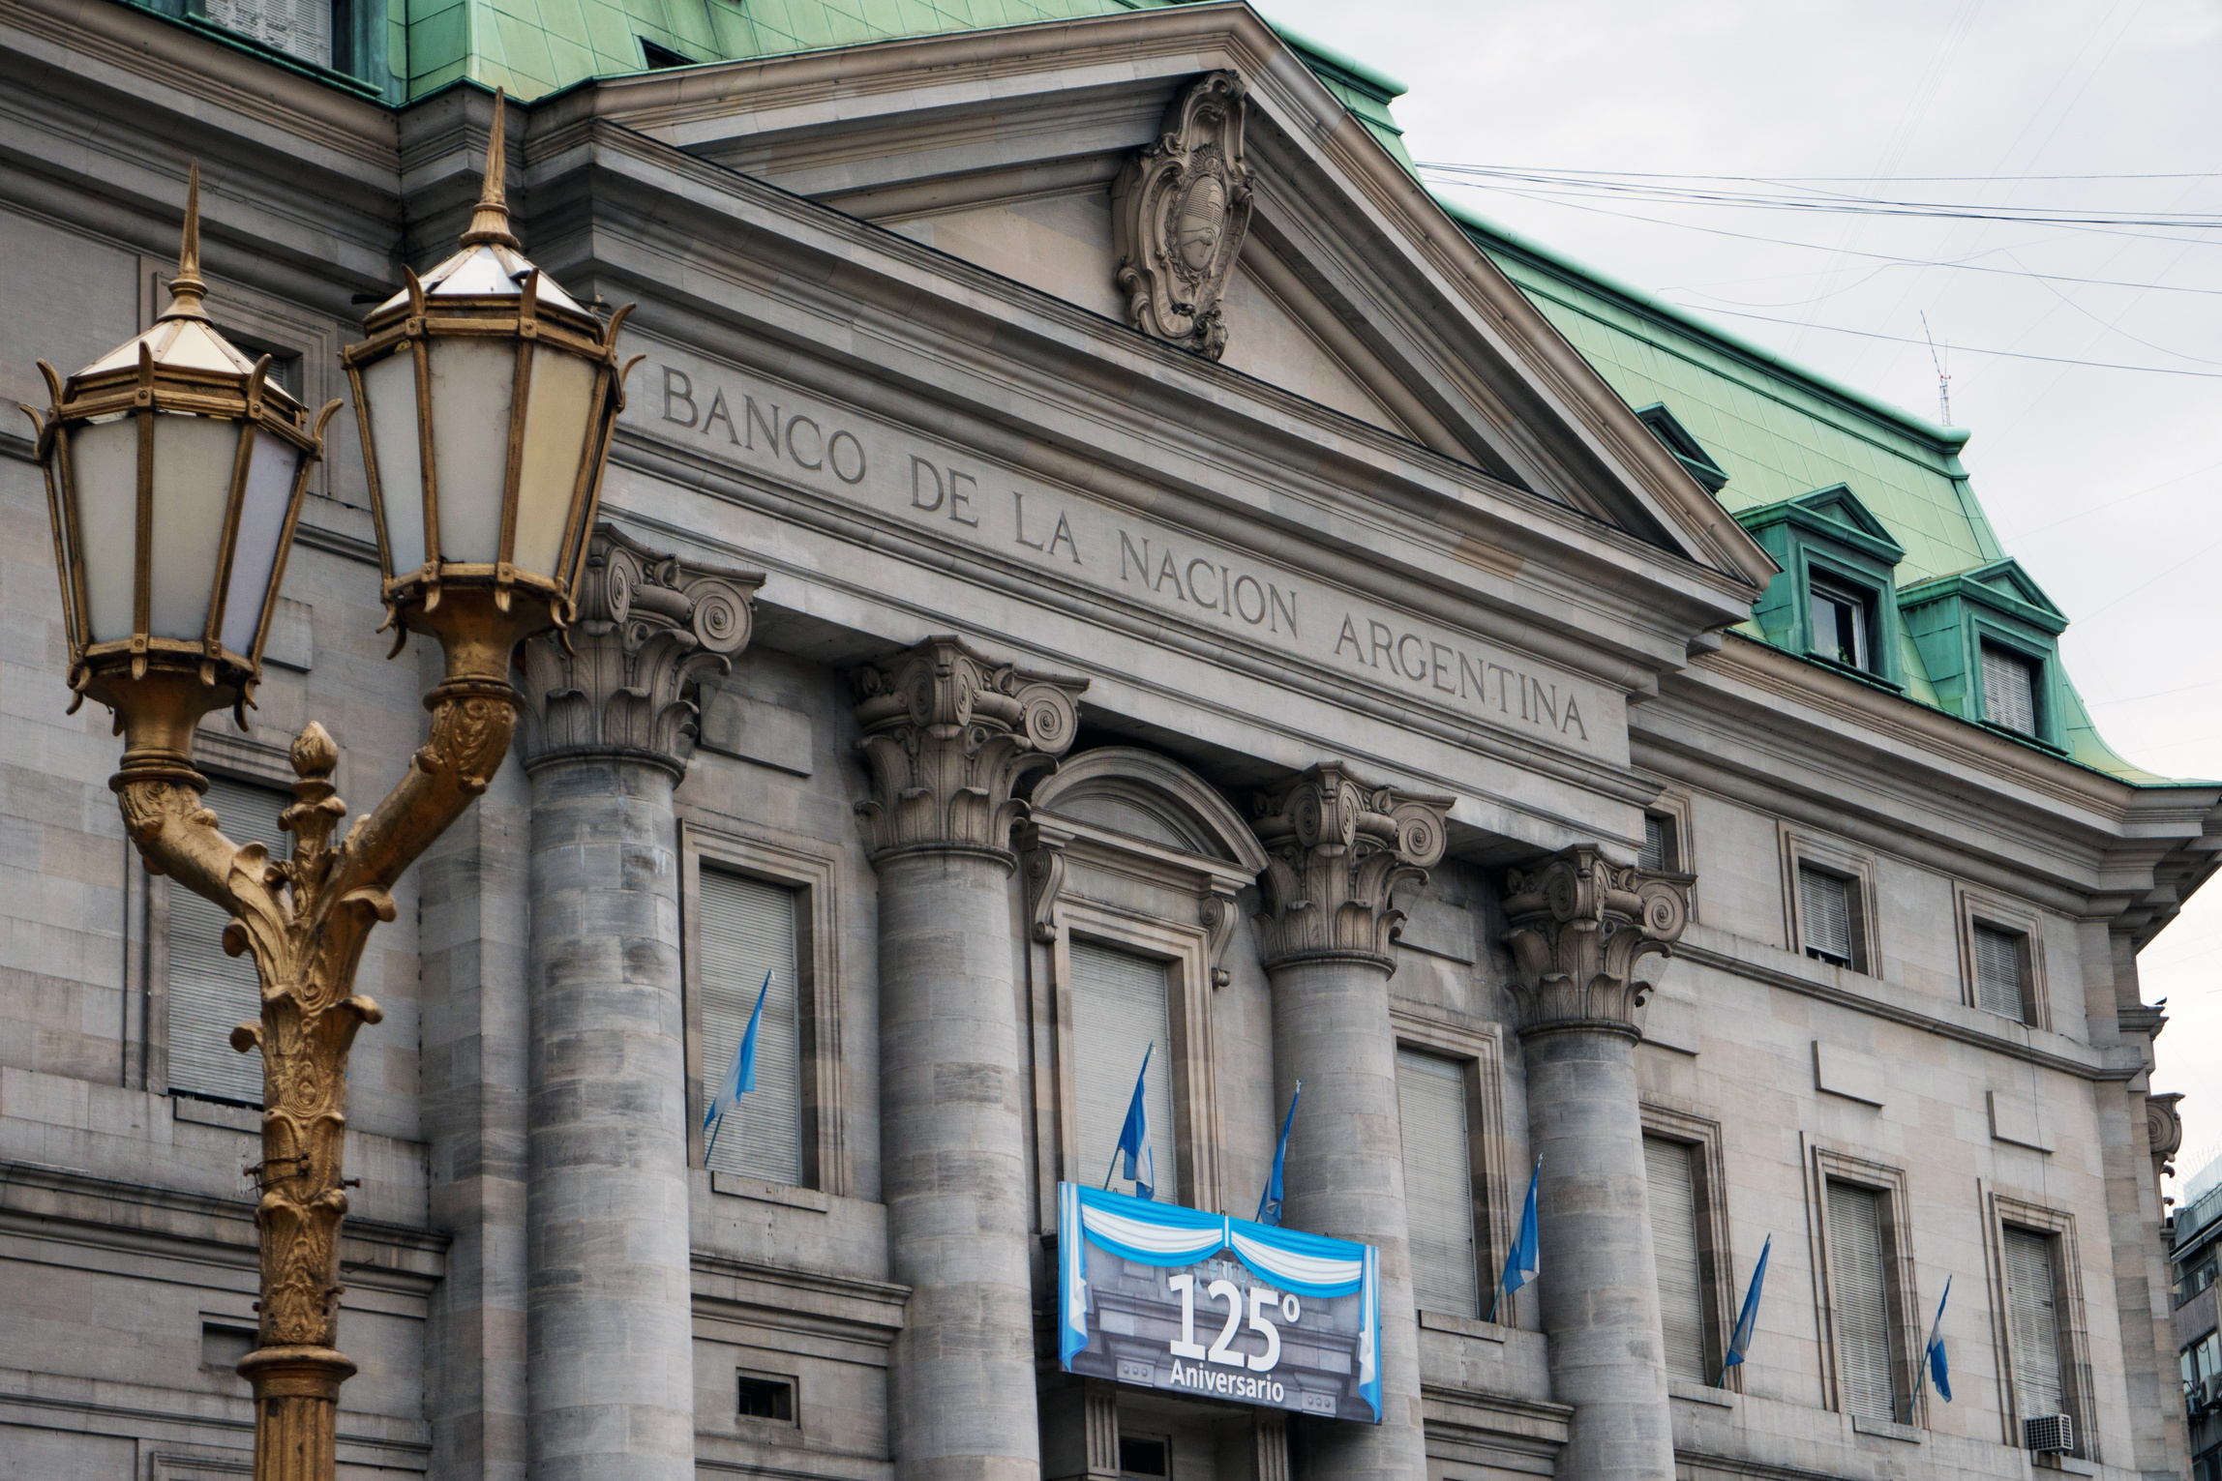
The Future of Gold
  Central banks are increasing gold reserves
  Still considered the safest long-term store of wealth
  Tokenized gold is gaining popularity (digital gold)
Institution | Forecast Price (USD/oz) | Notes
JP Morgan | 4800 | Strong demand from central banks
Goldman Sachs | 4900 | Safe haven appeal and weakening USD
UBS | 5200 | Slower rate hikes and global uncertainties
HSBC | 4350 | Inflation hedge and continued investor demand
Bank of America | 4700 | Long-term bullish outlook with geopolitical risks

Slide 14
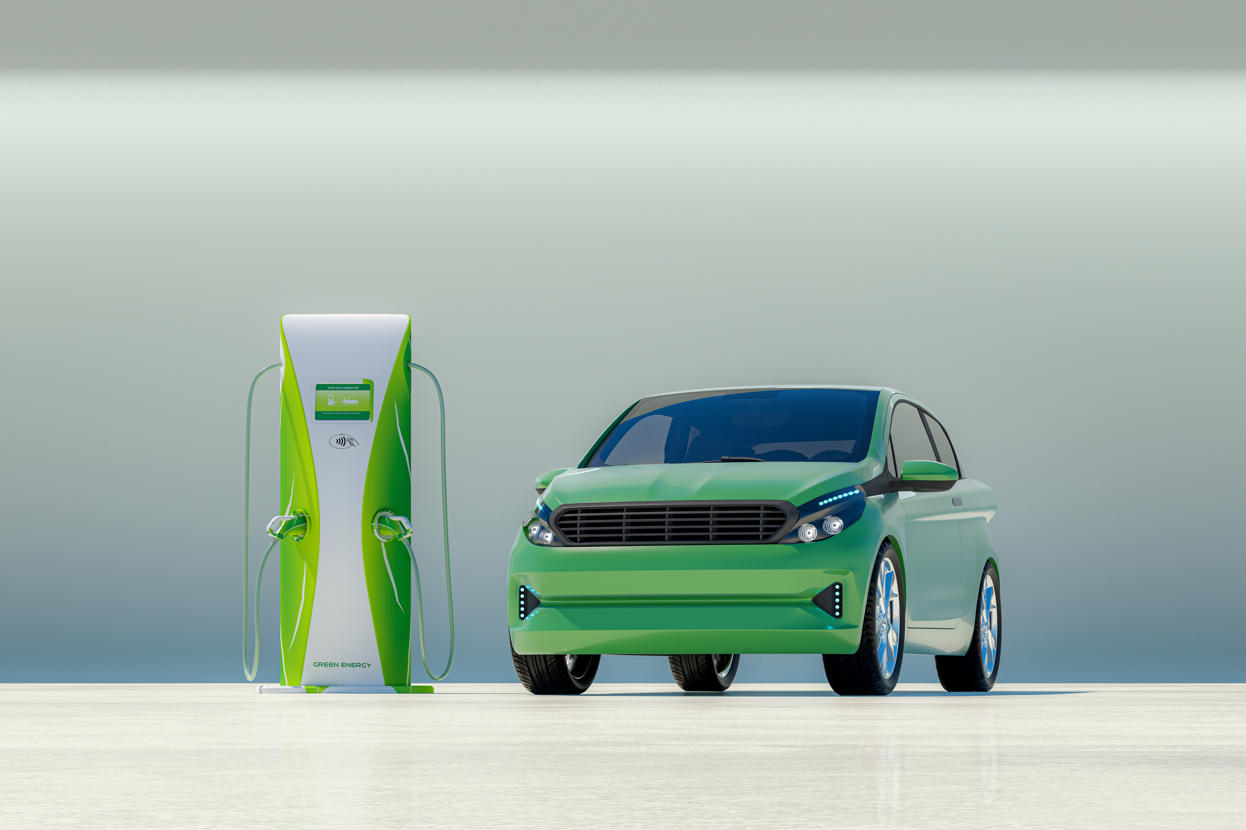
The Future of Silver
  High industrial demand: Solar panels, EVs, 5G
  Projected supply shortages in the next decade
  Analysts forecast higher long-term price growth than gold
Institution | Forecast Price (USD/oz) | Notes
JP Morgan | 120 | Higher industrial demand from solar and EV sectors
Goldman Sachs | 145 | Green transition driving silver consumption
UBS | 170 | Supply-demand imbalance projected
HSBC | 90 | Technical upside from investor accumulation
Bank of America | 90 | Silver seen as undervalued relative to gold

Slide 15

Interactive Questions
  Is it better to buy bars or coins?
  What is the ideal amount to start with?
  How can I sell later?

Slide 16

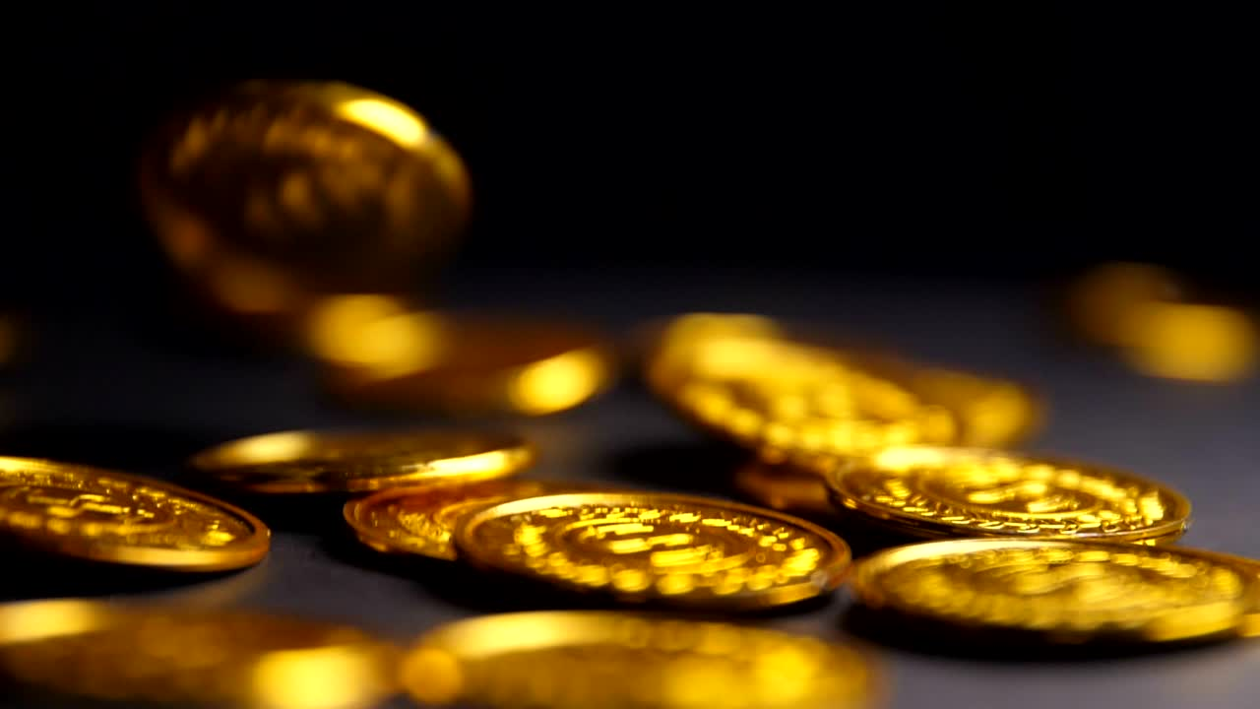
Thank You

